Slide 1
Object Recognition with Traditional Models
COMP 4447 Final Presentation
Jian Sun
Notes:
Welcome to my final presentation. My project is Object Recognition with Traditional Models.

Slide 2
Introduction
Focus
Evaluating traditional machine learning models for image recognition tasks using CIFAR-10.
Approach
Comparing performance and limitations of Support Vector Classifier and Random Forest models
Objective
Understand how traditional models can remain competitive in data-scarce scenarios.
Notes:
This study focuses on evaluating traditional machine learning models for image recognition tasks using CIFAR-10.
Evaluation approach is comparing performance and limitations of Support Vector Classifier and Random Forest models.
The ultra objective is to understand how traditional models can remain competitive in data-scarce scenarios.

Slide 3
Problem Statement Challenges in Real-World Applications of Deep Learning
Data Limitation
Typical real-world datasets are small, unlike massive datasets required by deep learning.
Resource Constraints
Deep learning models demand high computational power often unavailable in constrained settings.
Relevance of Traditional Models
Traditional models remain practical under data and resource limitations.
Notes:
Our research stands on the following problems.
We find Deep learning models face with 3 challenges: Data Limitation, Resource Constraints, and Relevance of Traditional Models.
Data Limitation means Typical real-world datasets are small, unlike massive datasets required by deep learning.
Resource Constraints means Deep learning models demand high computational power often unavailable in constrained settings.
Relevance of Traditional Models means Traditional models remain practical under data and resource limitations.

Slide 4
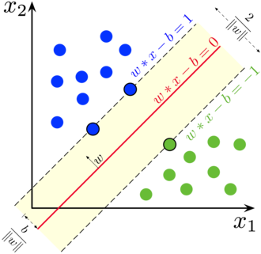
Research Objective Investigating Traditional Models in Object Recognition
Capability Analysis: Examine whether traditional models can effectively learn visual features.
Limitations Study: Identify specific challenges preventing traditional models from matching deep learning.
Performance Benchmarking: Measure classification accuracy using CIFAR-10 for SVC and RFC.
Notes:
Converting these 3 points to research question, we are going to study 3 sub-topics.
First one, Capability Analysis: we examine whether traditional models can effectively learn visual features.
Second one, Limitations Study: we Identify specific challenges preventing traditional models from matching deep learning.
Third one, Performance Benchmarking: we Measure classification accuracy using CIFAR-10 for SVC and RFC.

Slide 5
Selected Models Support Vector Classifier and Random Forest Classifier
Support Vector Classifier (SVC)
Finds optimal hyperplanes in high-dimensional space to separate classes.
Random Forest Classifier (RFC)
Ensemble of decision trees trained on random subsets to improve generalization.
Selection Rationale
These models are interpretable, computationally efficient, and require less data.
Notes:
To make the result more persuasive, we selected classic traditional ML models, Support Vector Classifier and Random Forest Classifier.
SVC is to finds optimal hyperplanes in high-dimensional space to separate classes.
RFC is the ensemble of decision trees trained on random subsets to improve generalization.
They are interpretable, computationally efficient, and require less data.

Slide 6
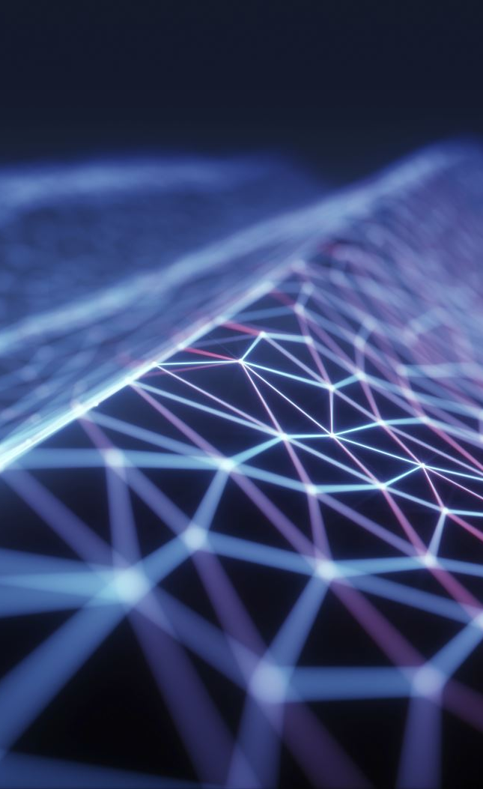
Model Details
Support Vector Classifier (SVC)
SVC uses kernel function (e.g. Radial Basis Function, polynomial) to transform data field for linear separation.
$$\frac{1}{2}{\left|\left|w\right|\right|}^{2}+C\sum_{i=1}^{n}{ξ_{i}}$$
SVC uses kernel function (e.g. Radial Basis Function, polynomial) to transform data field for linear separation.
𝟏/𝟐 |(|𝒘|)|^𝟐+𝑪∑_(𝒊=𝟏)^𝒏▒𝛏_𝐢
Random Forest Classifier (RFC)
RFC follows three steps:
bootstrap sampling for each tree
randomized construct each tree (maximizes information gain or entropy to split each node)
majority voting for prediction
Notes:
Here are the details.
SVC uses kernel function (e.g. Radial Basis Function, polynomial) to transform data field for linear separation.
RFC follows three steps:
bootstrap sampling for each tree.
randomized construct each tree (maximizes information gain or entropy to split each node).
majority voting for prediction.

Slide 7
Dataset Overview: CIFAR-10 Canonical Dataset for Object Classification
Dataset Size
60,000 color images in 10 classes with 6,000 images per class.
Image Format
Each image is 32x32 pixels with 3 RGB channels.
Purpose
Widely used for benchmarking object recognition models.
Notes:
Before talking about experiment, let’s go over the dataset, which is CIFAR-10, a widely used image dataset for benchmarking object recognition models.
It contains 60,000 color images in 10 classes with 6,000 images per class. Each image is 32x32 pixels with 3 RGB channels.

Slide 8
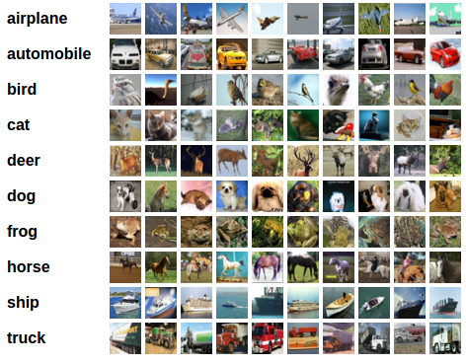
Sample Images from CIFAR-10 10 Object Class Visualized
Animal Classes: Includes bird, cat, deer, dog, frog, horse.
Vehicle Classes: Includes airplane, automobile, ship, truck.
Class Balance: Each class has an equal number of images: 6,000.
Notes:
The 10 classes include animal classes and vehicle classes. Each class has an equal number of images.
So it is a balanced dataset.
The right figure shows the data samples of each class.

Slide 9
Data Preprocessing Enhancing Image Input Quality
Augmentation Techniques
Random rotation (+-20º), flipping, and Gaussian noise added to boost robustness.
Normalization
Applied z-score normalization after flattening images from 3D to 1D.
Goal of Preprocessing
Increase generalization and reduce overfitting for traditional classifiers.
Notes:
To prepare the dataset for training, we did image augmentation, like random rotation, random flipping, and adding Gaussian noise, and z-score normalization.
This enhances the robustness and generalization of the model and reduces overfitting for traditional classifiers.

Slide 10
Experimental Design
Train model on Apple M3 CPU
Tune Hyperparameters in ablation studies
Notes:
All the model training and ablation study are done by Apple M3 CPU.

Slide 11
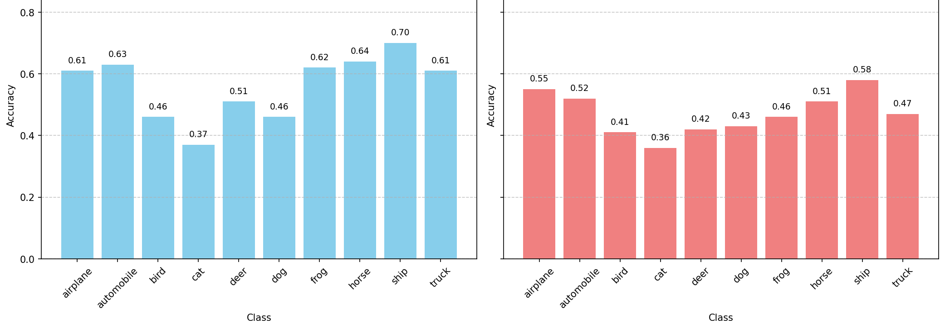
Experimental Results 1
SVC accuracy: 56.03%
RFC accuracy: 47.12%
Ship is easier to predict than others
Notes:
Here is the experimental results.
SVC achieved 56.03% accuracy, around 10% higher than RFC’s result, 47.12%. Hence, SVC performs better than RFC on the CIFAR-10 dataset.
Moreover, according to the above figure, Ship is easier to predict than others.

Slide 12
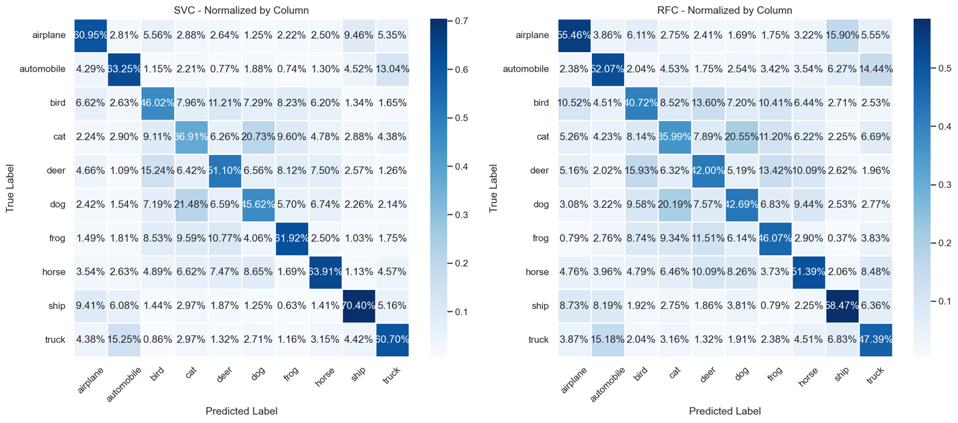
Experimental Results 2
vehicles are easier to predict than animals
Notes:
The heatmaps here support our view as well.

Slide 13
Experimental Results 3
Traditional model is less competitive than SOTA deep learning models, due to its weak representative capability.
Model | Accuracy
ViT-H/14 (Dosovitskiy, 2020) | 99.50%,
DINOv2 (Oquab, 2023) | 99.50%,
SVC (Ours) | 56.03%
RFC (Ours) | 47.12%
Notes:
Then, after introducing the performance of SOTA models into the comparison, we conclude that traditional model is less competitive due to its weak representative capability.

Slide 14
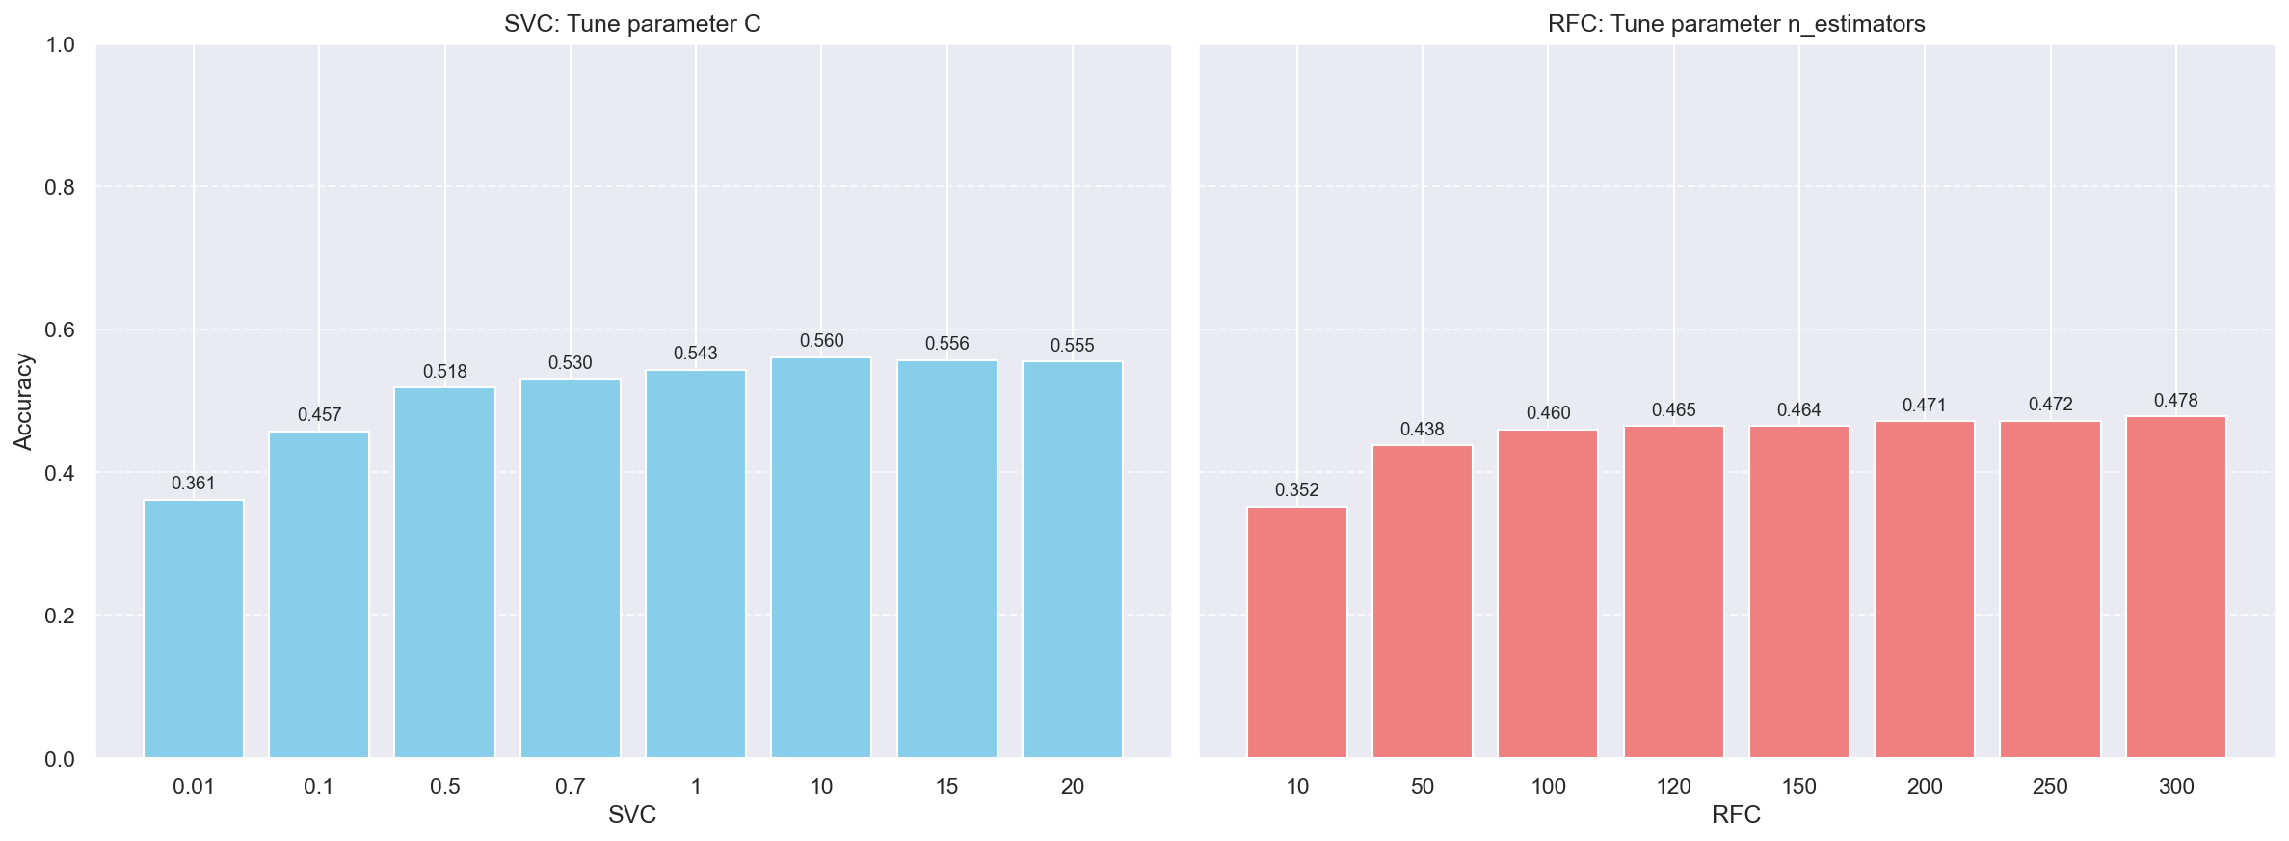
Ablation Study
1 Study the effectiveness of C on SVC performance
C = [0.01,0.1,0.5,0.7,1,10, 15]
best at C=10
2 Study the effectiveness of number of decision trees on RFC performance
n_estimators = [10,50,100,120,150,200,250,300]
best at n_estimators= 300
Tune C and number of decision trees
Notes:
In the meanwhile, to push the SVC and RFC to the best performance, we tuned their hyperparameter like C and n_estimators.

Slide 15
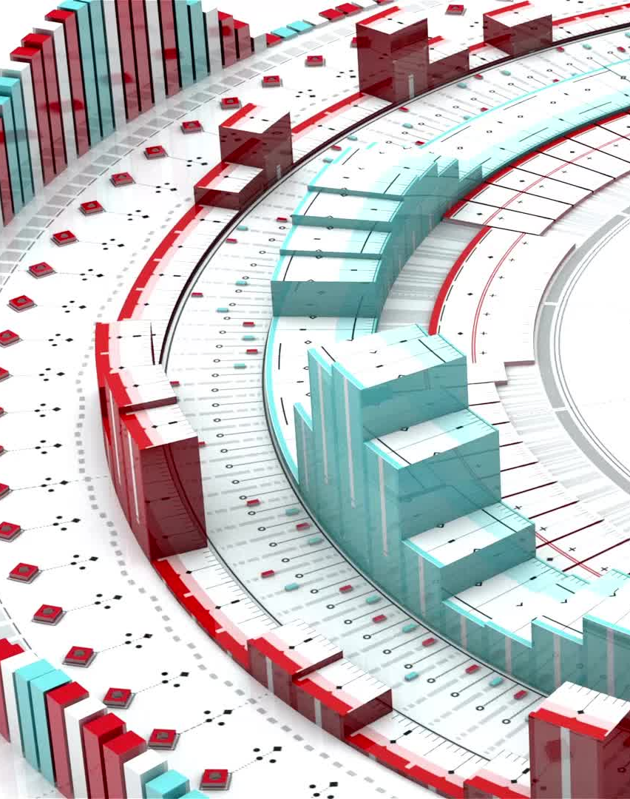
Discussion
Deep learning models extract much richer features by more convolved structure.
SVC and RFC only extract rare features by simple structure, impossible for reaching extremely good performance.
Feature richness drives performance differences of traditional models and deep learning ones.
Traditional models are stable and efficient but weak at feature extraction.
Notes:
So I still feel shock to such huge discrepancy on the model performance.
The followings may be the reasons.
Deep learning models extract much richer features by more convolved structure.
SVC and RFC only extract rare features by simple structure, impossible for reaching extremely good performance.
For example, deep learning models (ViT‑H/14, DINOv2) achieve 99.5% SOTA results with 632M and 1.1B tunable parameters.
SVC and RFC have 5 (C, kernel, gamma, etc) and 10+ (n_estimators, max_depth, max_features, min_samples_split, min_samples_leaf, etc.) tunable parameters.
Therefore, we say
Feature richness drives performance differences of traditional models and deep learning ones.
Traditional models are stable and efficient but weak at feature extraction.

Slide 16
Conclusion
SVC & RFC extract insufficient features → mediocre accuracy
1
SVC & RFC’s stability shows efficiency in learned representations
2
Notes:
The above experiment and discussion draw the conclusion
SVC & RFC extract insufficient features, leading to mediocre accuracy
SVC & RFC’s stability shows efficiency in learned representations.

Slide 17
Future Work
Improve representative learning in deep models
Enrich feature variations for traditional models
Traditional models focus on structured data rather than complex data modalities like video, audio, and images.
Maintaining stable performance on few-shot datasets
Notes:
In the future, we can improve traditional and deep learning models by
Improving representative learning in deep models
Enrich feature variations for traditional models
Traditional models focus on structured data rather than complex data modalities like video, audio, and images.
Maintaining stable performance on few-shot datasets

Slide 18

Q&A
Thank you

Slide 19

Backup
The parameter C is a regularization parameter that controls the trade-off between Maximizing the margin and Maximizing the margin.
Maximizing the margin (making the decision boundary as wide as possible).
Minimizing classification errors on the training data.

Slide 20
Goal of the Study Understanding Traditional Models for Object Recognition
Primary Inquiry
Can traditional models effectively perform object recognition in small-data scenarios?
Comparison Focus
Evaluate how traditional models perform relative to deep learning methods.
Practical Implications
Identify scenarios where traditional approaches are advantages.

